Slide 1
Mini project parser tutorial

Slide 2
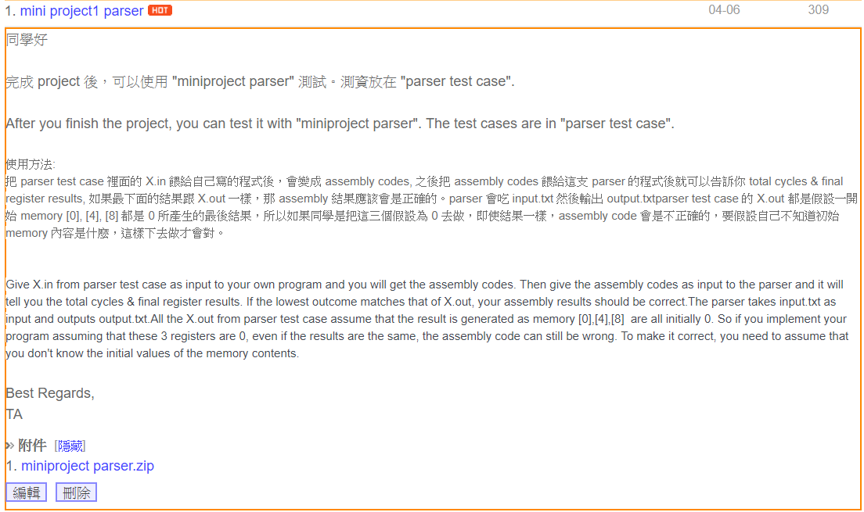
Step1 : Download miniproject parser.zip

Slide 3
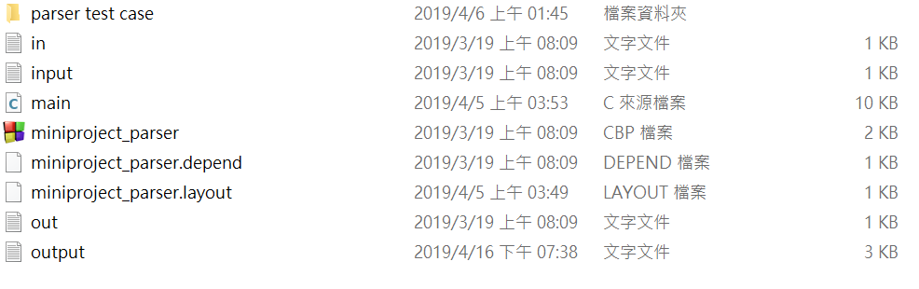
Step2 : Unzip miniproject parser.zip

Slide 4
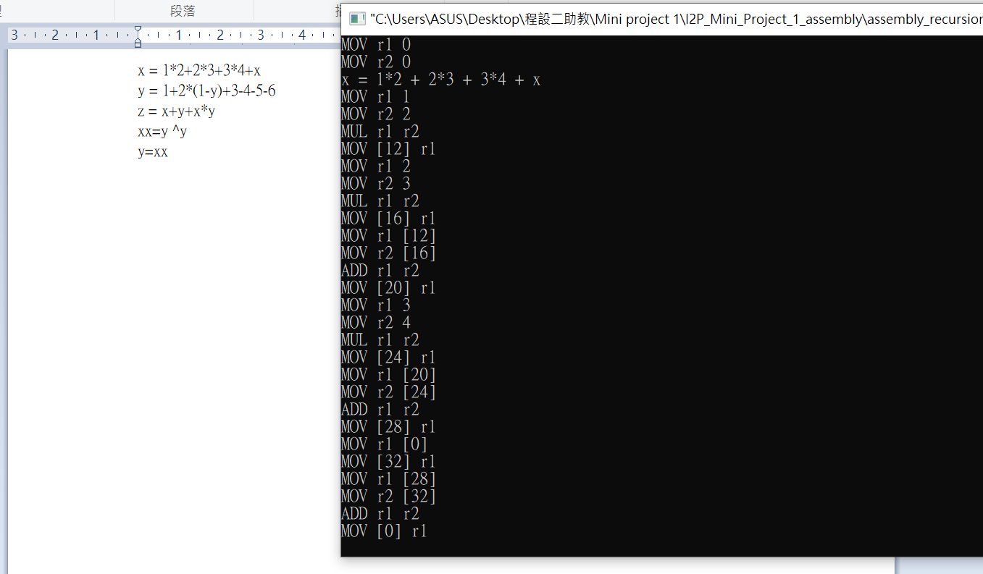
Step3 : Give X.in from parser testcase as input to your own program

Slide 5
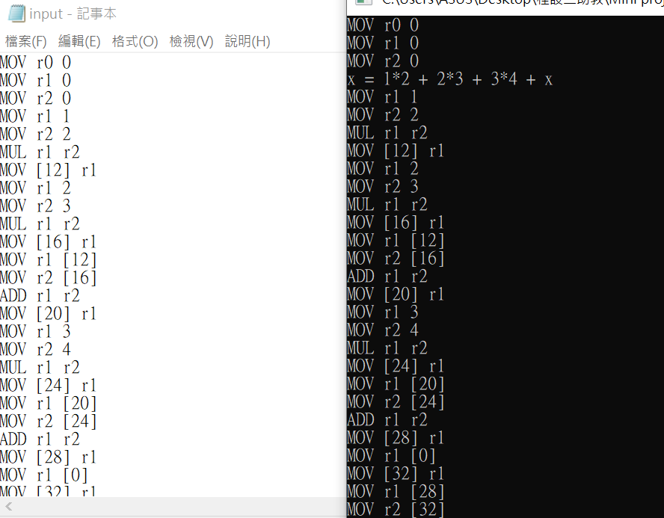
Step4 : Copy your assembly code to input.txt in miniproject parser

Slide 6
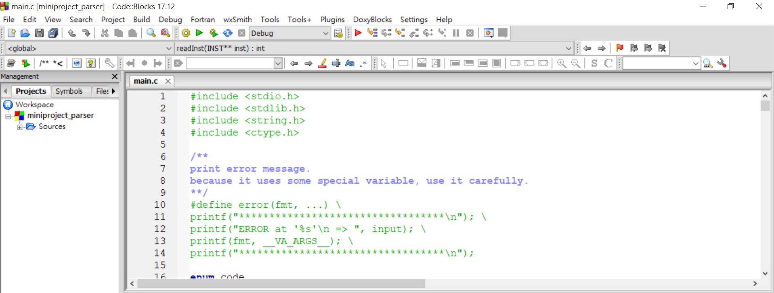
Step5 : Build and run main.c in miniproject parser

Slide 7
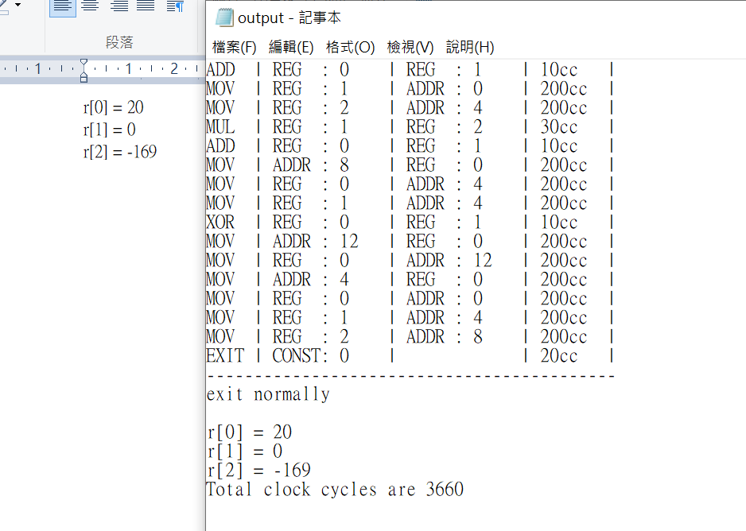
Step6 : check output.txt in miniproject parser.zip

Slide 8

Step7: Debug and optimize

